Slide 1
Aristotelian Legacies
Contemporary political theory and policy

Slide 2
History of political thought
Machiavelli – Governing in the common interest vs. particular interests. Character and corruption
Social contract critique
Rousseau – General will vs. particular wills and the will of all.
Karl Marx - ‘Species-being’ vs. ‘alienated labour’, workers as tools.

Slide 3
From the Politics…
‘ A state’s purpose is to provide something more than a military pact of protection against injustice, or to facilitate mutual acquaintance and the exchange of goods…All who are anxious to ensure good government under good laws must have an eye on the virtue and vice of the citizens. Thus it is evident that what is genuinely and not just nominally called a state must concern itself with virtue. Otherwise the association is a mere military alliance , and the law becomes a mere agreement, but unable to make citizens good and just.‘
(Bk 3, Ch ix)

Slide 4
The Capabilities approach
Emerged as a leading framework for development economics and policy. Widely researched and debated.
Key question: ‘What is she able to do and be?’
Positive form of freedom
Resources are a means, not an end in themselves.
Nussbaum and/vs. Sen
Nussbaum – Identifies provisional list of core capabilities for discussion. Capabilities cannot be traded off / substituted.
Sen – List should be the product of public debate and democratic process within particular societies.

Slide 5
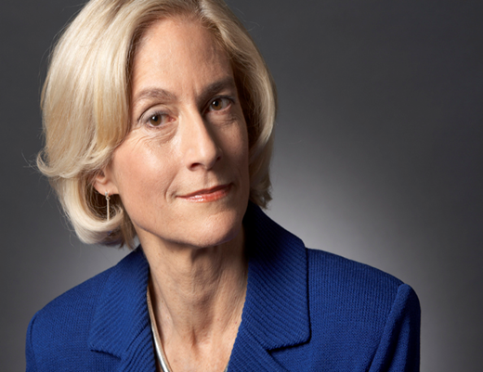
Nussbaum: Aristotelian social democracy
Aim - articulate the value of a modern ‘Aristotelian’ political conception where the aim of policy is to maximize the potential for fully flourishing life for all citizens. ‘No citizen should be lacking in sustenance’ Introduces concept of ‘capabilities’ and the ‘capabilities approach’
Three core elements:
1. Substantive ‘thick vague’ conception of full human functioning (capabilities)
2. Aim of politics is to support full human functioning and to do so by treating all as free and equal.
3. Institutional arrangements provisional based on need.
Martha Craven Nussbaum

Slide 6
Nussbaum’s Central Human Capabilities
Life
Bodily health
Bodily integrity
Senses, imagination and thought
Emotions
Practical Reason *
Affiliation *
Other species
Play
Control over one’s environment: A)Political and B) Material

Slide 7
Nussbaum’s list of central human capabilities
1. Life. Being able to live to the end of a human life of normal length . . .
2. Bodily health.
3. Bodily integrity. Being able to move freely from place to place; being able to be secure against violent assault, including sexual assault . . .
4. Senses, imagination, thought. Being able to use the senses; being able to imagine, to think, and to reason . . . ; being able to use one's mind in ways protected by guarantees of freedom of expression with respect to both political and artistic speech and freedom of religious exercise; being able to have pleasurable experiences and to avoid non beneficial pain
5. Emotions. Being able to have attachments to things and persons outside ourselves; being able to love those who love and care for us . . . not having one's emotional developing blighted by fear or anxiety.

Slide 8
Central Human Capabilities, cont’d
6. Practical reason. Being able to form a conception of the good and to engage in critical reflection about the planning of one's own life.
7. Affiliation Being able to live for and in relation to others, to recognize and show concern for other human beings, to engage in various forms of social interaction; being able to imagine the situation of another and to have compassion for that situation; having the capability for both justice and friendship. . . . Being able to be treated as a dignified being whose worth is equal to that of others.
8. Other species. Being able to live with concern for and in relation to animals, plants, and the world of nature.
9. Play. Being able to laugh, to play, to enjoy recreational activities.
10. Control over one's environment. (A) Political: being able to participate effectively in political choices that govern one's life; having the rights of political participation, free speech and freedom of association . . . (B) Material: being able to hold property (both land and movable goods); having the right to seek employment on an equal basis with others . . .

Slide 9
Policy applications

Slide 10
UN Human Development index (HDI) “People are the real wealth of a nation” [1990 HDR]
Developed for the United Nations Development Program (UNDP) by Amartya Sen and Mabub al Haq in 1990 as an alternative to GDP as a measure of human development.
“The HDI was created to emphasize that people and their capabilities should be the ultimate criteria for assessing the development of a country, not economic growth alone. The HDI can also be used to question national policy choices, asking how two countries with the same level of GNI per capita can end up with such different human development outcomes”

Slide 11
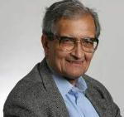

Sen on development and the HDI
“Human development, as an approach, is concerned with what I take to be the basic development idea: namely, advancing the richness of human life, rather than the richness of the economy in which human beings live, which is only a part of it.“
Video interview with Sen:
https://vimeo.com/16439165

Slide 12
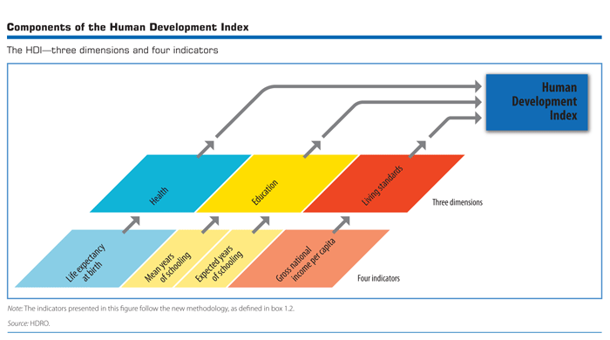
Human development index (HDI)

Slide 13
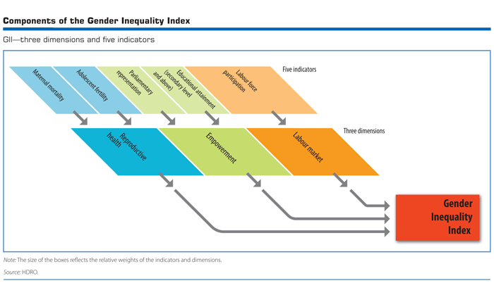
Gender development index

Slide 14
Research on happiness and well-being
Expanding (exploding?) international research by economists , social psychologists , and geographers.
Happiness and Public Policy programme/ Centre for Economic Performance (LSE) Well-Being Institute (Cambridge) Earth Institute (Columbia)
Major OECD research project to create the ‘Better Life Index’ http://www.oecdbetterlifeindex.org/
In June 2016 the OECD committed itself “to redefine the growth narrative to put people’s well-being at the center of governments’ efforts”.
Scottish Curriculum for Excellence emphasis on ‘Health and Well Being’
**********

Slide 15
Happiness and wellbeing
Eudemonic vs. Hedonic well-being
Key question: ‘All in all, how satisfied are you with your life?’
Research links HWB to health, wealth and education. Relative income does matter, but after a threshold further wealth does not result in increased happiness.

Slide 16
2018 World Happiness Report
‘Happiest’ Countries
Key Factors
1.Finland (7.632)
2. Norway (7.594)
3. Denmark (7.555)
4. Iceland (7.495)
5. Switzerland (7.487)
6. Netherlands (7.441)
7. Canada (7.328)
8. New Zealand (7.324)
9. Sweden (7.314)
10. Australia (7.272)
1. real GDP per capita,
2. healthy life expectancy,
3. having someone to count on,
4. perceived freedom to make life choices,
5. freedom from corruption,
6. and generosity

Slide 17
Final thoughts…….
Beginning and basis of an ongoing conversation
Key concerns in classical and renaissance thought:
A good life – what is it and how can politics support it?
Citizenship and political leadership
Corruption (self and factional interests)
The structure of a stable and just state.
The character, aim and method of politics and social science.
Insights and ideas

Slide 18
Central questions
What is the aim and nature of human life? What is the aim and nature of politics ?
What are the best forms of government – and for what circumstances?
What is the legitimate basis of political authority? To what ends is it exercised?
When can revolution be justified?
What is the relationship of economic forces to politics?
What are the limits of justified constraint on individual liberty?

